Slide 1

GLASS FAÇADE & FLEX REST OF MAHARASHTRA – SMART BAZAAR

Slide 2
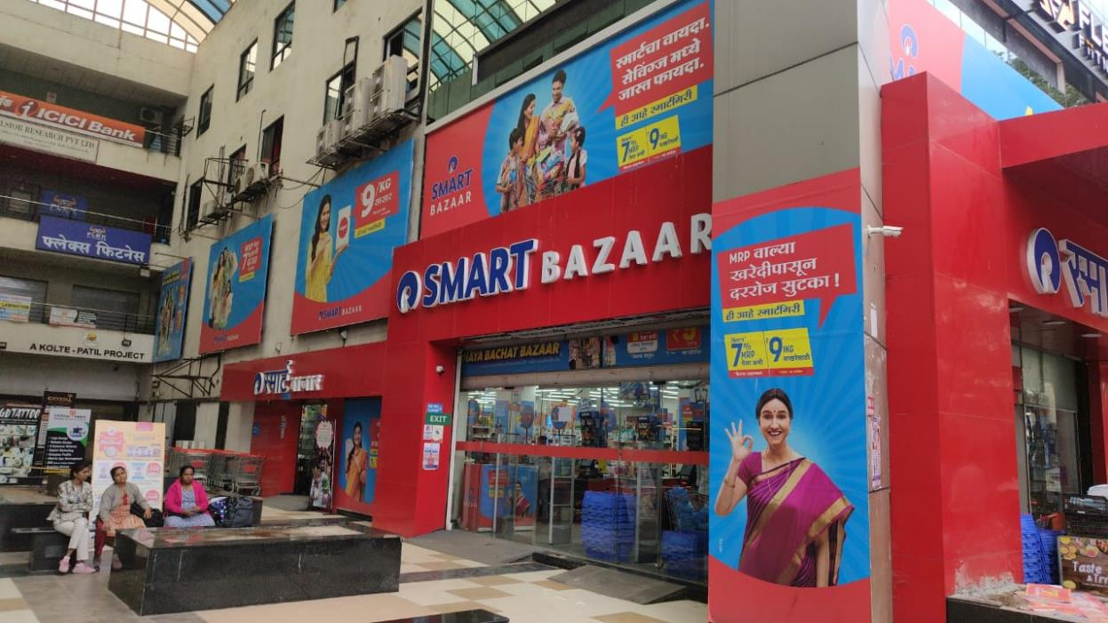
FRAJ
Vishrantwadi ,Pune
W : - 226
H :- 140
Qty :- 1
Media :- Flex
Remark :- MS Frame

Slide 3
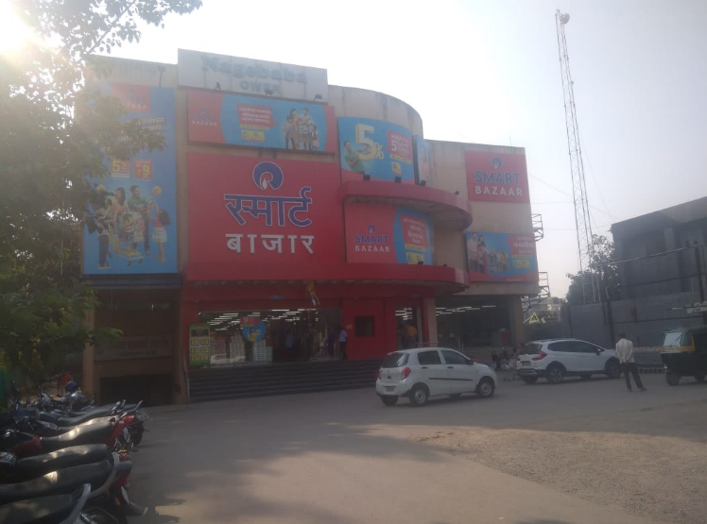
FRAL-Ahmednagar
W : - 216
H :- 144
Qty :- 1
Media :- Flex
Remark :-

Slide 4
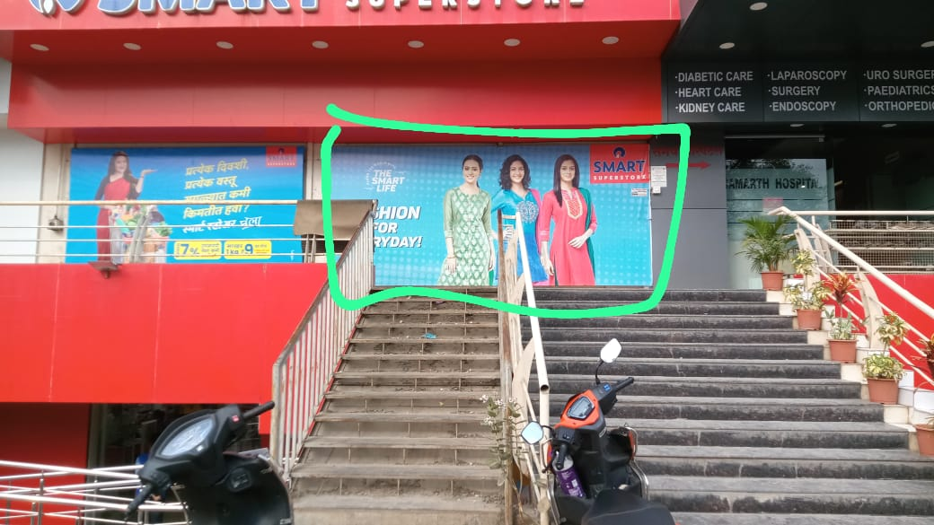
TPT7-Talegaon
W_180
H _ 84
Qty_ 1
Media _ Flex

Slide 5

TQ70-Wagholi
Pune
Size : W-136in x H-84in
1 Qty
Surface : Star Flex
Print Material : Star Flex

Slide 6
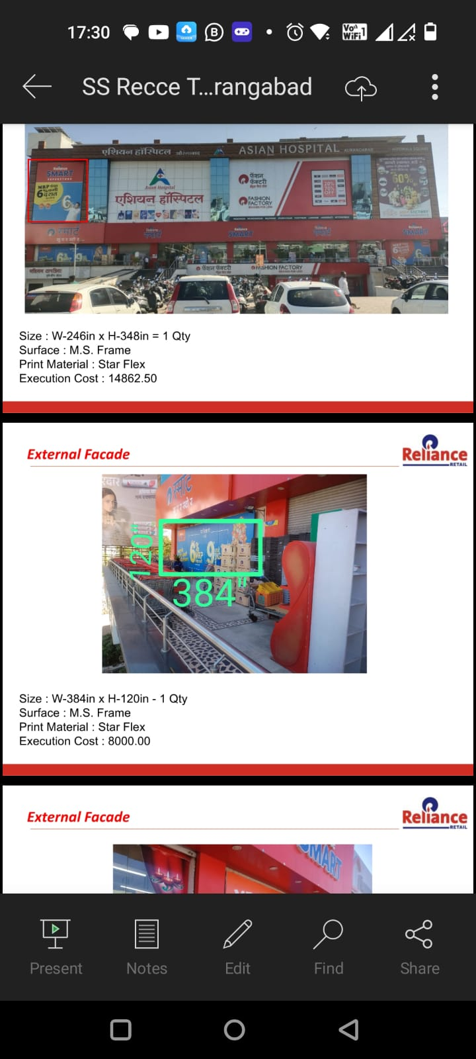
TU19-Aurangabad
Size : W-246in x H-348in - 1 Qty
Surface : M S Frame
Print Material : Star Flex
Size : W-384in x H-120in - 1 Qty
Surface : M S Frame
Print Material : Star Flex

Slide 7
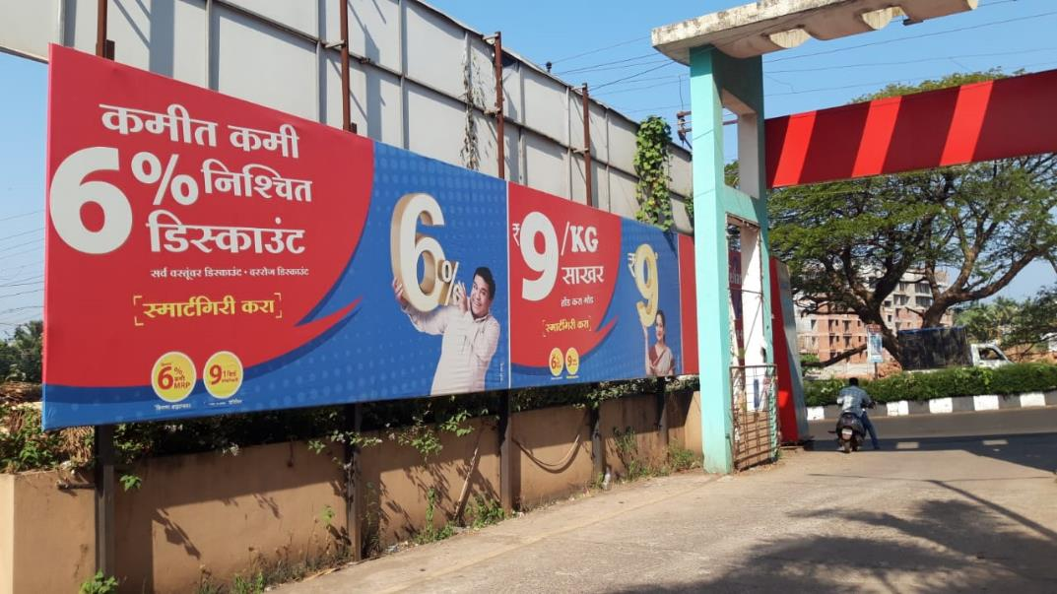
TQ58-Ratnagiri
Size : W621.6 in x H 96 in
Qty 1
Surface :
Print Material : Flex + Frame

Slide 8

TGL3-Wakad
Pune

Slide 9
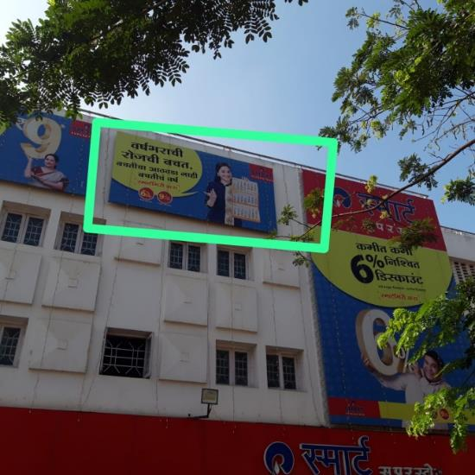
TDC9-Ichalkaranji
Pune
Size : W-156 in x H-78in –
1 Qty
Surface :Top Wall
Print Material : Flex + Frame + scaffolding

Slide 10
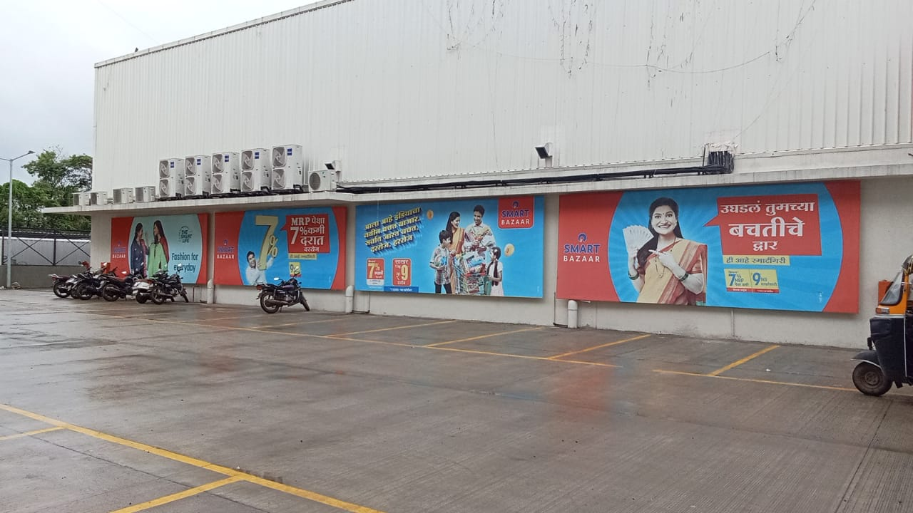
TMN0-Moshi
Pune
W -240 inch _
H – 96 inch _
Qty - 4 Media – Flex

Slide 11
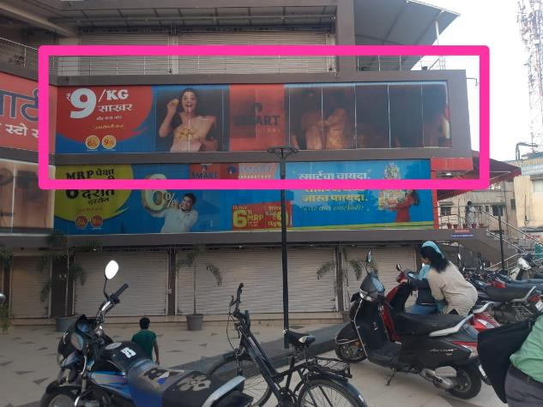
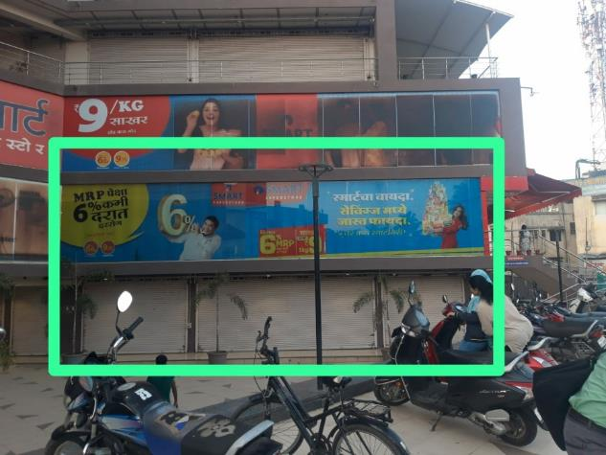
TMX1-Satara
Size : W 648in x H115in
Surface : Glass + Scaffolding
Print Material : Vinyl
Size : W 612in x H115in
Surface : Glass + Scaffolding
Print Material : Vinyl

Slide 12
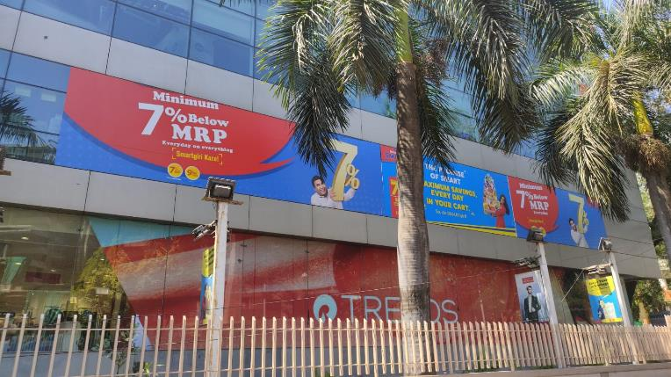
6719-Erandwane
Pune
External façade Logo
W _909 Inch
H _ 107 inch
Qty 1
Media- Glass Vinyl BB

Slide 13
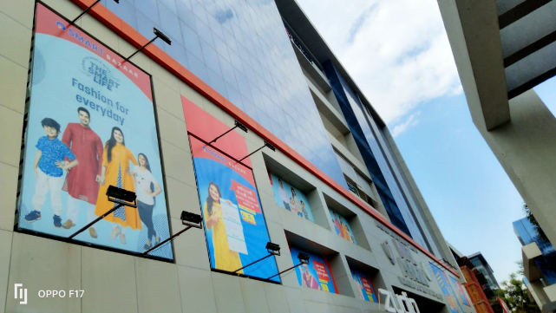
Size W – 141’’ x H – 239’’
Media – Star Flex
FRAD-Nagpur

Slide 14

Size W – 141’’ x H – 177’’
Media – Star Flex
FRAD-Nagpur

Slide 15
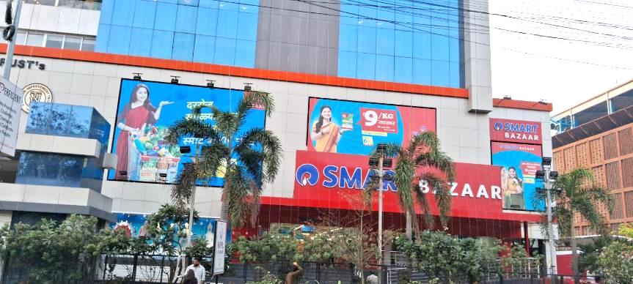
FRAD-Nagpur
Size W – 332’’ x H – 236’’
Media – Star Flex
Size W – 320’’ x H – 140’’
Media – Star Flex

Slide 16
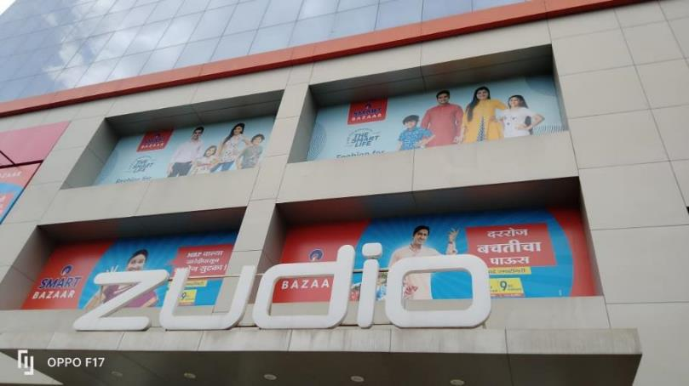
FRAD-Nagpur
Size W – 212’’ x H – 102’’
Media – Eco Solvent Vinyl

Slide 17
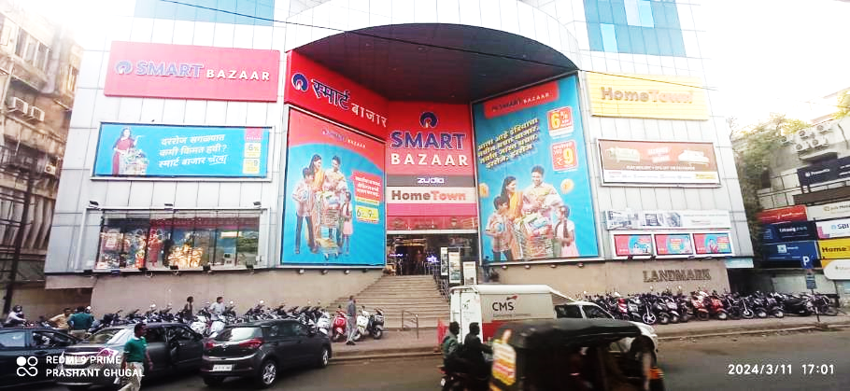
FRAB-Nagpur
Size W – 336’’ x H – 109’’
Media – Star Flex
Size W – 96’’ x H – 48’’
Media – Star Flex

Slide 18
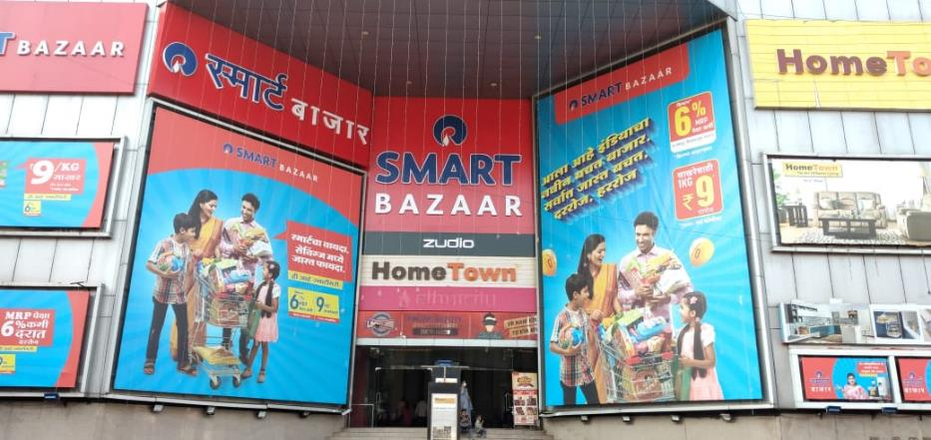
FRAB-Nagpur
Size W – 325’’ x H – 340’’
Media – Star Flex
Size W – 336’’ x H – 490’’
Media – Star Flex

Slide 19

FRAC- Nagpur
Size W – 206’’ x H – 81’’ Media – Star Flex

Slide 20

FRAA-Nagpur
Size W – 39’’ x H – 141’’
Media – Eco Solvent Vinyl
Size:- 288” x 108” –
Media – Eco solvent Vinyl

Slide 21
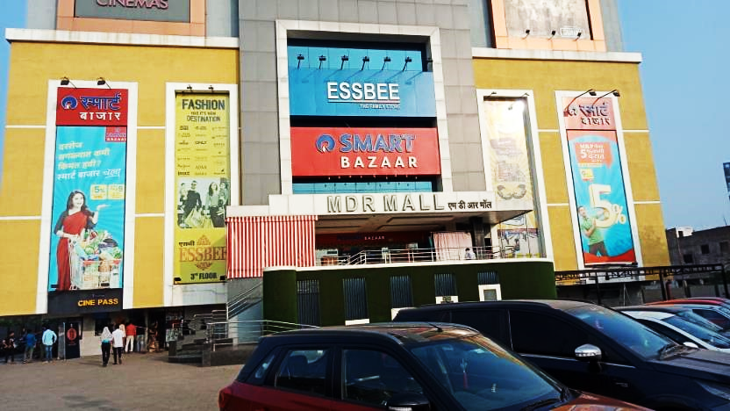
FRAE-Chandrapur
Size:- 131” x 349”
Media – Eco solvent Vinyl

Slide 22
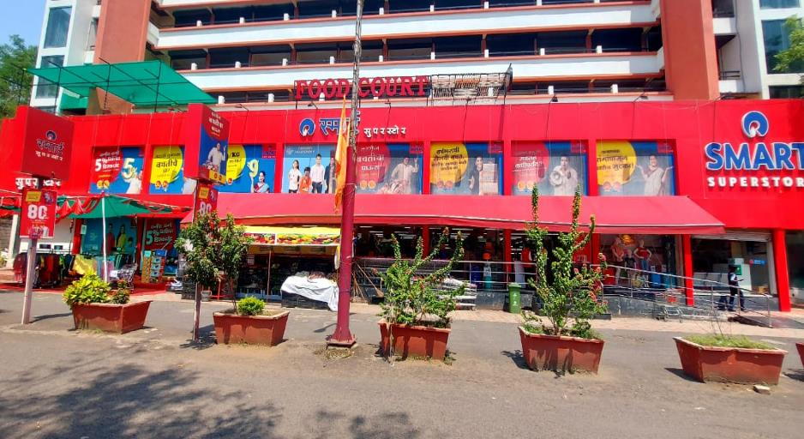
TIZ5-Wani
Yavatmal
w 140” x h 92”
Vinyl Qty 8

Slide 23
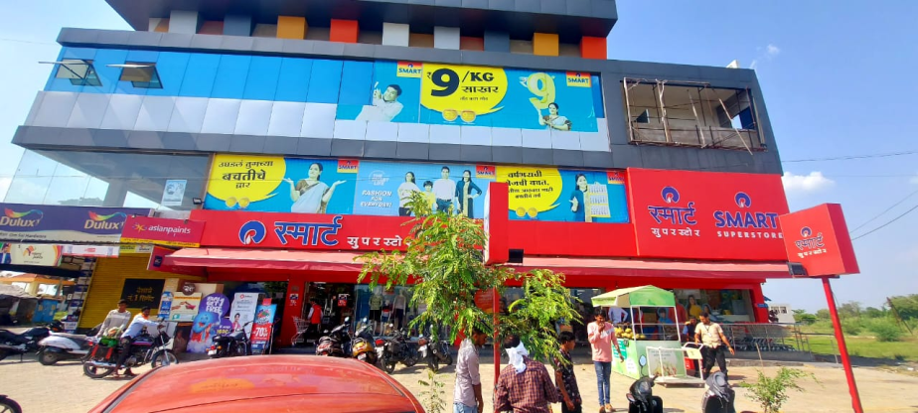
TLI2-Umred
Nagpur
W 208” x H 84”
Eco Solvent VINYL

Slide 24
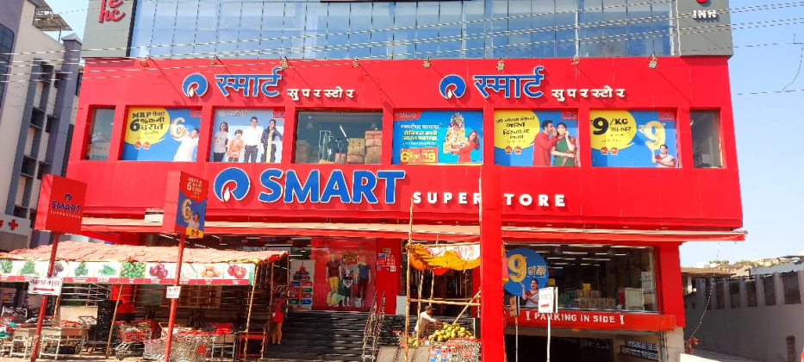
Type : oneway
w 111”x h 79”
Qty-2
TXGA-Yavatmal
Type : oneway
w 110.5”x h 79”
Type : oneway
w 124”x h 79”
Qty-2

Slide 25
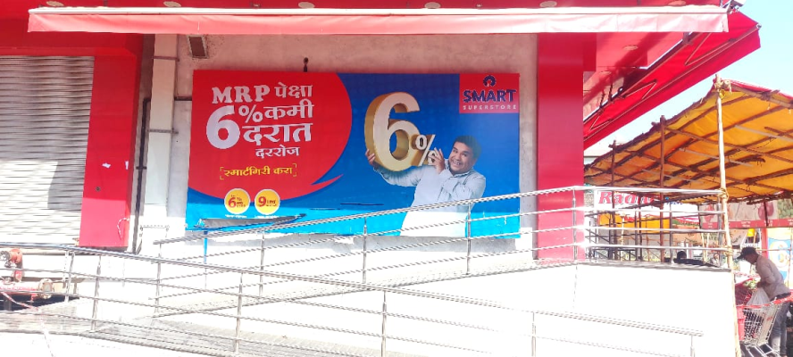
TXGA-Yavatmal
w 15 ft x h 90”
Flex

Slide 26
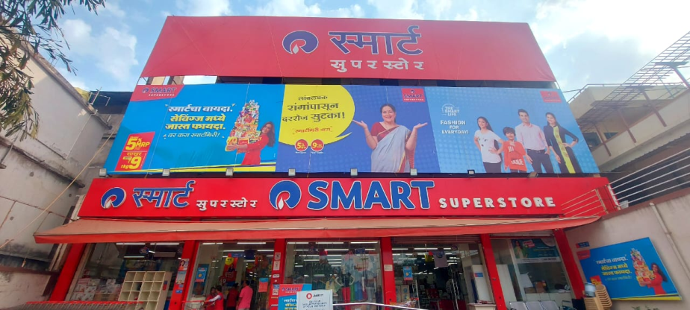
TPM4-Nagpur
w 844” x h 186” Flex

Slide 27
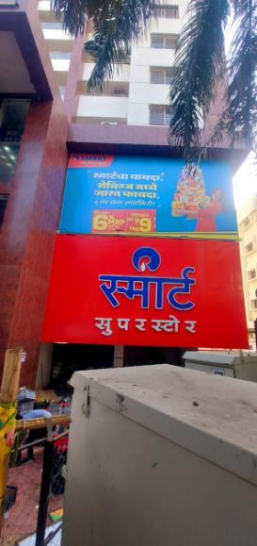

TPM4-Nagpur
w 328” x h 185” Flex
w 173” x h 237” Vinyl

Slide 28

TUD1-Bhandara
w 705” x h 84”
Eco Solvent Vinyl

Slide 29

Thank You

